Slide 1
Do it, like we do
13: Neural Nets & Deep Learning

Slide 2
Structure
Week 1: Introduction
Week 2: Syntax, Variables & Functions
Week 3: Control Structures
Week 4: Lists & Collections
Week 5: RegEx & Strings
Week 6: Sorting & I/O
Week 7:Debugging, Errors & Strategies
Week 8: 4P: Packages, Practices and Patterns
Week 9: Object Oriented Programming
Week 10: Time, Space & Documentation
Week 11: Numpy & Matplotlib
Week 12: Python & Science
Week 13: Neural Nets & Deep Learning
Week 14: Honorable Mentions & Wrap Up

Slide 3
Last Week's Homework

Slide 4
Week 11: Plotting
Do not call get_x_y() twice. Many times we saw x = get_x_y()[0] y = get_x_y()[1]
This calls the function twice! Meaning it is fully calculated twice and each time half of the results are discarded
One figure means that all plots should be in one window (not necessarily the same plot though)
This was an issue with some sine wave solutions

Slide 5
Week 12
Documentation was a bit lacklustre
Writing the data to a file seems to have been difficult for some
Using open() and then subsequentially writing into it for each trial would have been one way
Maybe have a look again at the solutions to get an idea of how it can work
A mistake on our sides: the circle was meant to disappear after pressing a key
But that was not explicit in the task description

Slide 6
Disclaimer
Notes:
This will be a rather shallow and not in depth overview of the topic and some Python libraries
The topic is too complicated to be explored richly in 90 minutes
We will skip over most of the math and statistics, but if you want to dive deeper into this field, you should have a look at those

Slide 7
Why Neural Networks

Slide 8
Why Neural Networks?
Biological neural networks are pretty amazing, general problem solvers
We take ~0.1 seconds for scene recognition, are able to operate our body parts at high precision, can process (different) language(s) in ~0.6 seconds, learn and adapt to our environment with analogous reasoning to solve novel tasks, memorise a lot, ……….
We are pretty bad at symbolic computing though
This is pretty much opposite of what computers are
Not entirely true, but computers are mostly good at symbolic computing and not that great at analogous reasoning and plasticity
The idea is to create software that emulates biological properties
Artificial Neural Networks

Slide 9
The catch
The brain is a fairly complex organ
On average a neuron has several thousand connections
This means an immense level of parallel processing
E.g. scene recognition takes around 100 steps to do, but is highly parallelised^{[4]}
Fruit Fly: 250,000
Honey Bee: 960,000
Cat: 300,000
[1]
Human: 80,000,000,000

Slide 10
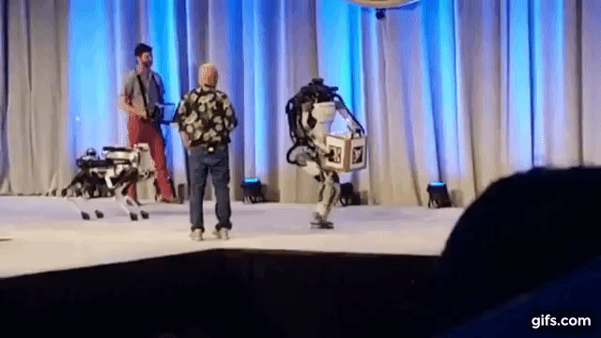
A comparison
A fruit fly has 250,000 neurons
It can
Navigate flying and walking
That already involves scene perception and motor control
Recognise and find food
Find mates & reproduce
Learn and retain information
www.youtube.com/watch?v=TxobtWAFh8o
[1]

Slide 11
The Transition

Slide 12
Biological to Artificial: The Takeaway
The rate in which a neuron fires encodes its activity
Inputs from other neurons influence the activity of the neuron
Inputs can be weighted
The activation of a neuron is non-linear
Meaning below a certain threshold there is nearly no activity
Once the threshold is reached, the activity increases (a lot)
But there is not much more, the rate of fire quickly saturates
All neurons essentially share the same cell structure

Slide 13
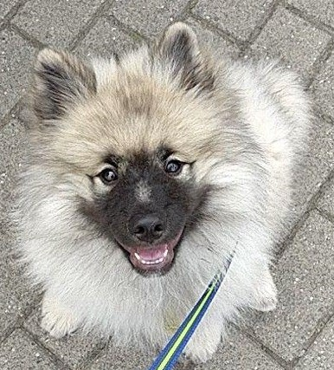
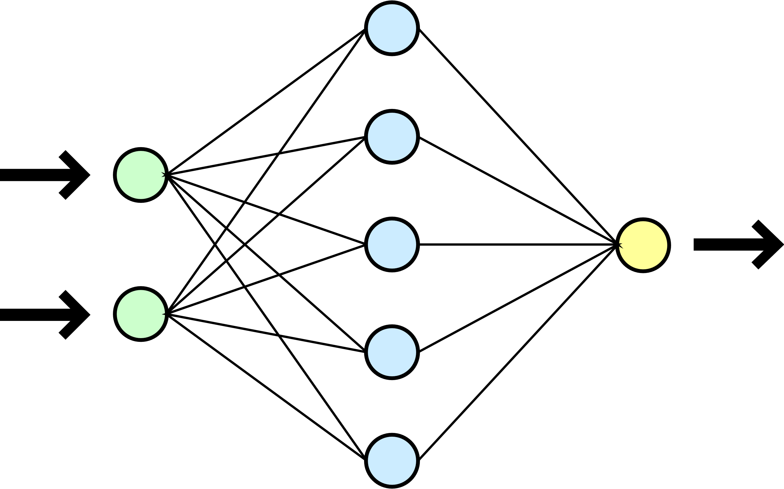
Biological to Artificial: Modelling
A neural network gets a certain set of inputs
E.g. light entering our eye, resulting in activity through the optic nerve
Those inputs then are processed
In some way
It is a black box. We do not know exactly what is happening inside
Output is produced
E.g. the knowledge that those patterns of light waves are reflected by a cute dog.
The brain thus is some function that maps inputs to outputs
Brain
f( ) = “A cute dog!”
“A cute dog!”

Slide 14
Biological to Artificial: Modelling
Artificial Neural Networks abstract the biological black box to an artificial black box
There is one kind of neuron. They all work the same.
It is not as interconnected
It is not as dynamic as the biological model
Look up reservoir computing for a more biological approach
The data is processed sequentially, instead of highly parallelised
“A cute dog!”

Slide 15
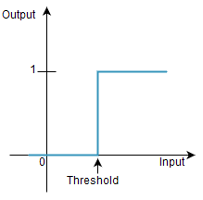
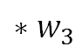
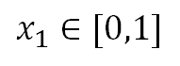
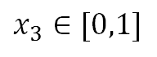
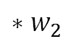
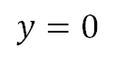
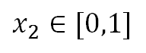
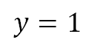
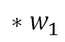

Biological to Artificial: The Perceptron
One of the fundamental building blocks
Its purpose is to recreate biological neurons
Most basic neurons in ANNs work in a similar fashion
It gets inputs that are either 0 or 1
The inputs are then weighted and summed up
If they exceed a certain threshold the neuron “fires” and outputs a 1, otherwise a 0
This is called a step function
$$x_{1}∈[0,1]$$
$$∗w_{1}$$
$$y=1$$
$$Σ$$
>= threshold
$$x_{2}∈[0,1]$$
$$∗w_{2}$$
$$∗w_{3}$$
< threshold
$$y=0$$
$$x_{3}∈[0,1]$$
Notes:
Shade example on the board? w1 = -1
w2 = 2
w3 = 1
Giraffe: 3 boxes
Tiger: 2 boxes
Frog: 1 box
Threshold: 2.5

Slide 16
Artificial Neural Networks

Slide 17
A Good Start
“At some fundamental level, no one understands machine learning.”
- Christopher Olah, 2014^{[3]}

Slide 18
What are Artificial Neural Networks?
Artificial Neural Networks (ANNs) are a machine learning approach
Like with most machine learning algorithms the idea is simple: ANNs learn from the data presented to them and figure out a solution
ANNs have come up as early as the 50’s
But since 2006 the field exploded
This is mostly due to a collection of techniques which are now known as deep learning
Having far more computing power and large amounts of data sets certainly helped, and probably are the two main reasons for the spike in usage since 2012

Slide 19
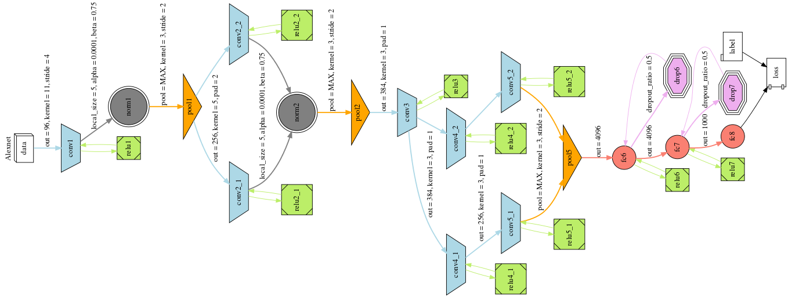
What is Deep Learning?
It is a family of algorithms used to extract, model and predict structure in data
The deep comes from the structure of those models
Deep learning models form from simple structures more and more complex structures
It is thus a layered approach. A deep learning model consists of many layers
Neural Networks are probably the most prominent example of deep learning
AlexNet, Wikimedia commons

Slide 20
What is Deep Learning?
So far we have written problem specific algorithms
Small precise tasks that together solve a bigger problem
They were tailor made to fit one specific problem and solve that
This form of problem solving works well if we can formulate the way to the goal in a structured, unambiguous manner
Surprise: We cannot always do this
In Deep Learning we structure an ANN – the architecture
This is basically the outline for the problem solving strategy the computer should use
The computer then learns from the data and figures out the solution (or a good approximation) to the given problem

Slide 21
Learning & Behind the Scene

Slide 22
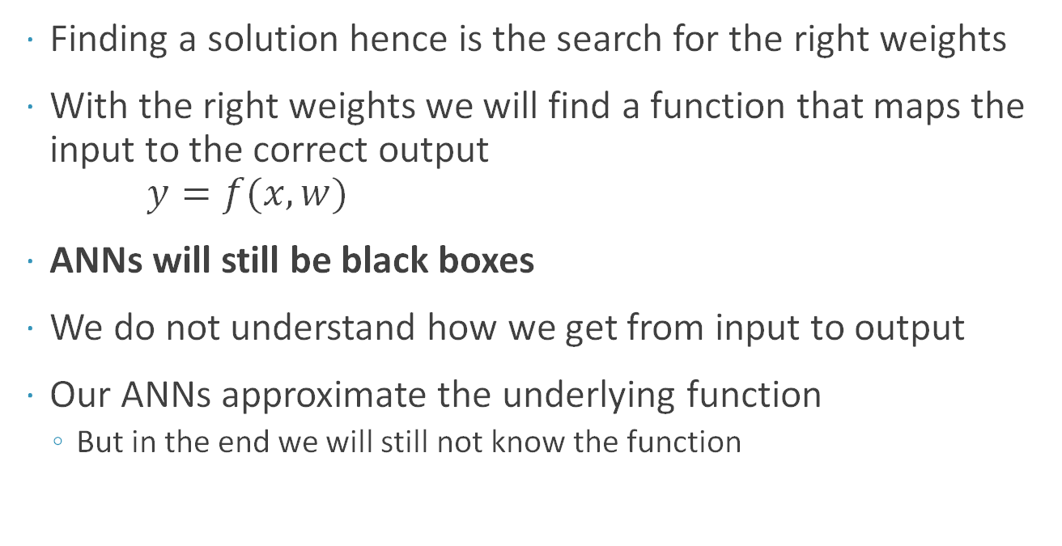
Blackbox Stays Blackbox
Finding a solution hence is the search for the right weights
With the right weights we will find a function that maps the input to the correct output $y=f(x, w)$
ANNs will still be black boxes
We do not understand how we get from input to output
Our ANNs approximate the underlying function
But in the end we will still not know the function
w
w
w
w
w
w
w
w
w
w
w
w
w
w
w
“A cute dog!”

Slide 23
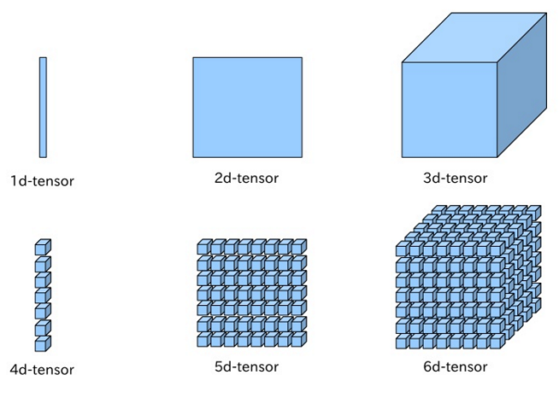
Tensors
Tensors are the generalisation of vectors and matrices (an nd-array)
“0”d would be a scalar
a single number
1d tensors would be vectors
A list/group of numbers
2d tensors would be matrices
So many vectors grouped together
Everything above is just a tensor
3d is still fairly imaginable: a group of matrices
https://leonardoaraujosantos.gitbooks.io/artificial-inteligence/content/linear_algebra.html

Slide 24
The Input
We can feed a lot of things into our network, as long as they are numbers
We can convert a lot of things into numbers though
As said last week: pictures, audio and video are already just numbers anyway
Text is a bit more complicated and there are several solutions (e.g. word2vec)
So the input is a tensor with one or many dimensions (often it is 1d, a vector)
A picture, for example, can be converted into a vector by “flattening” it into one row
The input vector than has a dimensionality of pixel-width * pixel-height * colour depth
Colour depth is how many values are used to represent the colour of the pixel
This is often 1 (grayscale), 3 (rgb, hsv, etc.) or 4 (rgba)

Slide 25
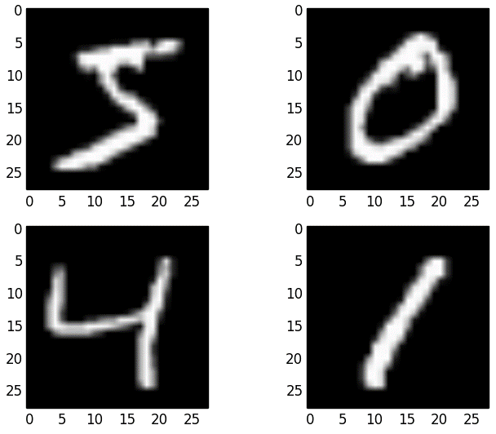
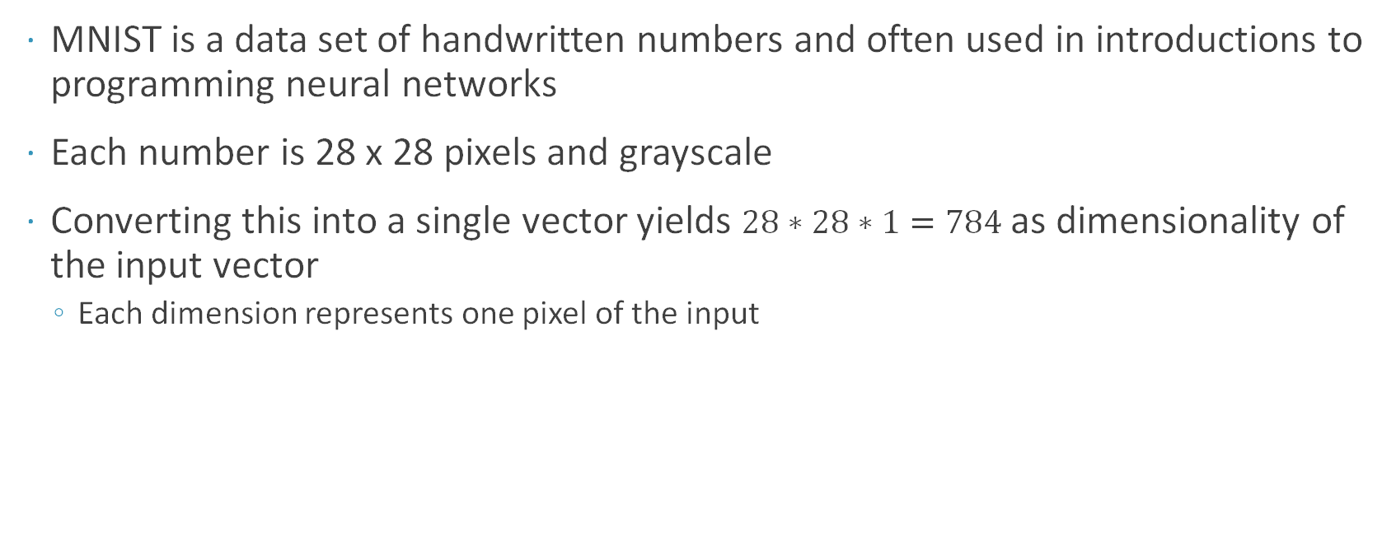
The Usual Start: MNIST
MNIST is a data set of handwritten numbers and often used in introductions to programming neural networks
Each number is 28 x 28 pixels and grayscale
Converting this into a single vector yields $28∗28∗1=784$ as dimensionality of the input vector
Each dimension represents one pixel of the input

Slide 26
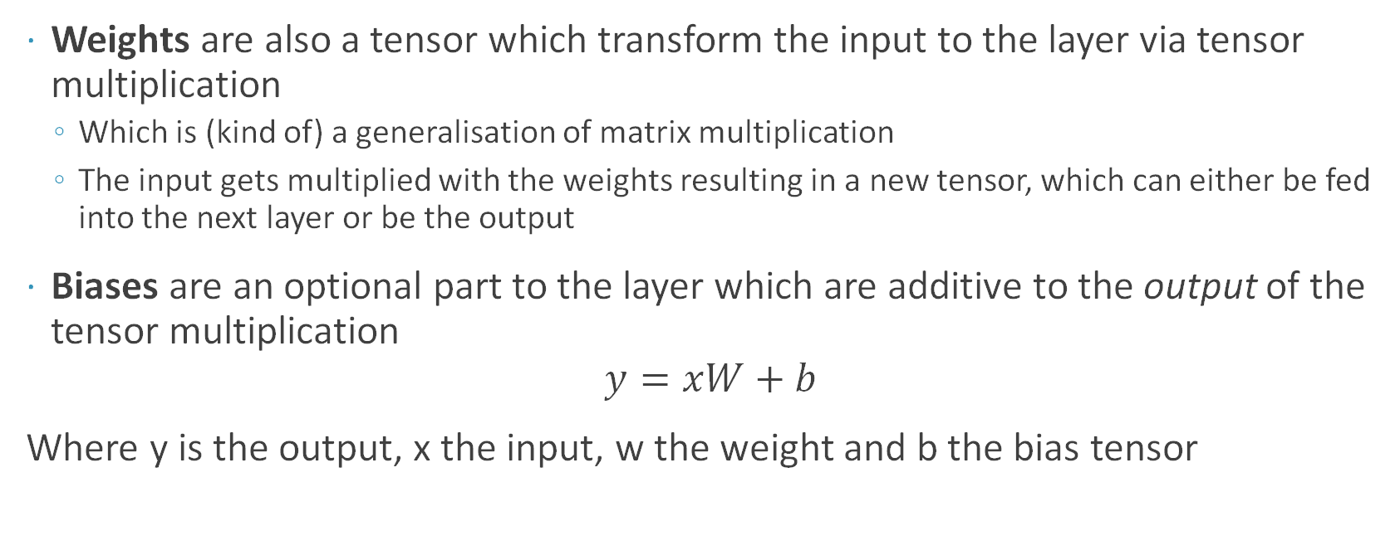
Weights and Biases
Weights are also a tensor which transform the input to the layer via tensor multiplication
Which is (kind of) a generalisation of matrix multiplication
The input gets multiplied with the weights resulting in a new tensor, which can either be fed into the next layer or be the output
Biases are an optional part to the layer which are additive to the output of the tensor multiplication
$$y=xW+b$$
Where y is the output, x the input, w the weight and b the bias tensor

Slide 27

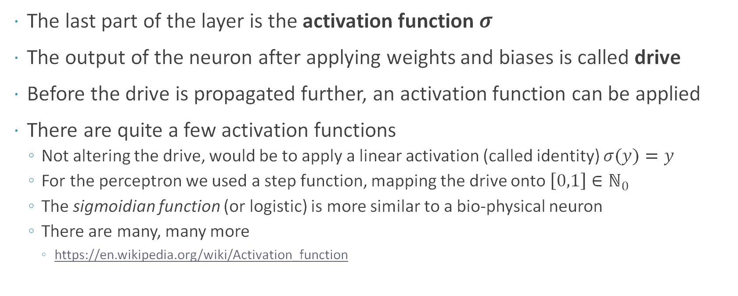
The Activation
The last part of the layer is the activation function $σ$
The output of the neuron after applying weights and biases is called drive
Before the drive is propagated further, an activation function can be applied
There are quite a few activation functions
Not altering the drive, would be to apply a linear activation (called identity) $σ(y)=y$
For the perceptron we used a step function, mapping the drive onto $\left[0,1\right]∈ℕ_{0}$
The sigmoidian function (or logistic) is more similar to a bio-physical neuron
There are many, many more
https://en.wikipedia.org/wiki/Activation_function

Slide 28
Learning
Get Inputs
Calculate Output
Compare Output to desired Output
Change the weights a little
The basic process for a network to learn
You feed the inputs in
The network produces some output
That output is (not manually) compared to the desired output
The desired output is a label attached to the input we fed into the network
Use that result to change the weights a little to better predict inputs in the future
This is called backpropagation
The big caveat: We need to have labelled samples for our network to learn

Slide 29
Learning
There are three major types of learning
Supervised Learning
Example from before. Data is labelled by a “teacher”.
Task is to map the input to the given label as an output
Unsupervised Learning
There is no “teacher”. Data is unlabelled
No straightforward way to measure accuracy. The effect of learning is coded in the rules.
Reinforcement Learning
Learning by doing
A “weak teacher” is present telling when the goal or fail state was reached
The network needs to find the way by itself

Slide 30
Learning
Another learning method that gains more popularity
Semi-supervised learning
Start with unsupervised learning and generate a form of pre-structure
Use some labelled data sparingly after unsupervised learning to improve result
It stands somewhere between supervised and unsupervised learning

Slide 31
Training
Letting a network learn is called training
In this process the data is fed in, the weights are adjusted and data fed in again
This is repeated for a while
Often we do not have enough data to train the network with unique samples, and we need to show the same data twice
Iterating through the whole data set once, is called an epoch
Training can take a long, long while
Training is also a fairly complex process with several strategies and subtasks

Slide 32
(A Part of) The ANN Family

Slide 33
Feed Forward Networks
Feed Forward Networks (FFN) the first and simplest type of ANNs
The perceptron is a FFN
The input moves through each layer directly through the output layer without cycles and loops
“A cute dog!”

Slide 34

Recurrent Neural Networks
In contrast to FFNs, data is not just propagated forward in Recurrent Neural Networks (RNNs)
Data is also moving backwards from later to earlier layers
In FFNs a sequence of inputs is handled each entry on its own, with no regard for earlier and following inputs
RNNs can deal with sequential data, by interconnecting neurons and saving some weighted data from previous inputs
François Deloche, Wikimedia commons

Slide 35

Convolutional Neural Networks
A convolutional neural network (CNN) is inspired by the organisation of the visual cortex
Each neuron responds to certain stimuli in a certain area of the input
CNNs have also been used in e.g. audio recognition
Aphex34, Wikimedia Commons

Slide 36
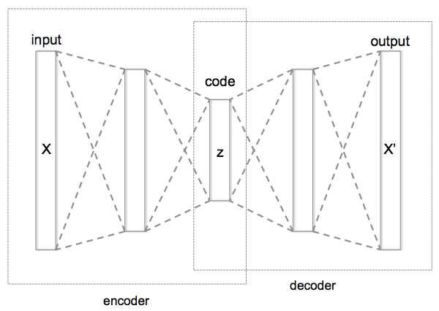
Autoencoder
Autoencoders are used to create efficient data codings
So to represent the same data, but with less memory
They are (usually) used with unsupervised learning
Chervinskii, Wikimedia commons

Slide 37
Frameworks

Slide 38


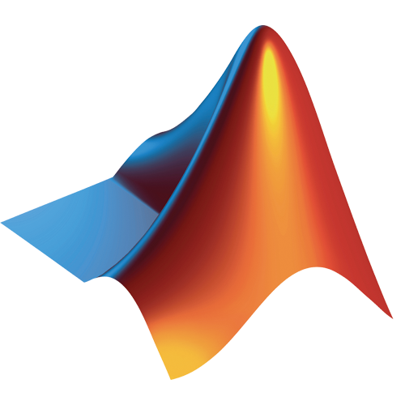







Frameworks

Slide 39
Frameworks
Framework | Written In | Interfaces | Initial Release | Maintainer
Caffe | C++ | Command Line, Python, C++ | March 2014 | Berkley Vision and Learning Center
Caffe2 | C++ | C++, Python | April 2017 | Facebook
CNTK (Microsoft Cognitive Toolkit) | C++ | C++, Python, Command Line | January 2016 | Microsoft Research
Matlab | C, C++, Java, Matlab | Matlab | ? | Mathworks
Chainer | Python, C | Python | January 2015 | Chainer.org, Community
Torch | C, Lua | Lua | October 2002 | Community Based
Pytorch (beta) | Python | Python | January 2018 (soon) | Facebook
MxNet | C++ | C++, Python, Julia, Matlabl JS, Go, R, Scala, Perl | December 2015 | Community Based (Apache Incubator)
Theano | Python | Python | August 2011 | Université de Montréal
TensorFlow | C++ | Python, C++ | November 2015 | Google

Slide 40
Frameworks
Keras is a high level, object oriented API for fast experimentation
It works on top of different other frameworks
That makes it nice to switch and test different frameworks
It is also fairly easy to get started with simple models
Difficult to expand however

Slide 41
Python Frameworks
There are a lot of frameworks with Python interfaces
The most recognisable are probably TensorFlow & Pytorch
Pytorch is still in beta but has one significant advantage
It allows for dynamic data structures, whereas most other frameworks use static graphs
This is awesome especially for dynamic systems and prototyping
Runnerup: CNTK
They are frequently updated and improved upon, popular, and grow fast
Fairly low level, allowing to be expanded and built upon for custom models
In the end, most frameworks are extremely similar
It is often fairly simple to switch between them

Slide 42
But how?

Slide 43
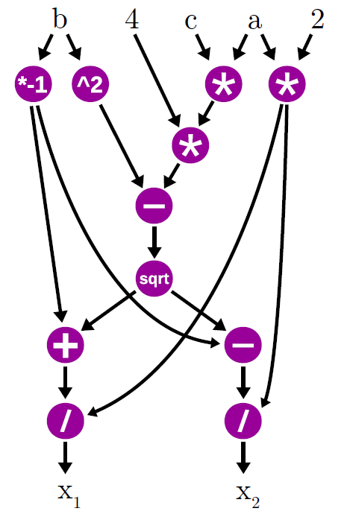
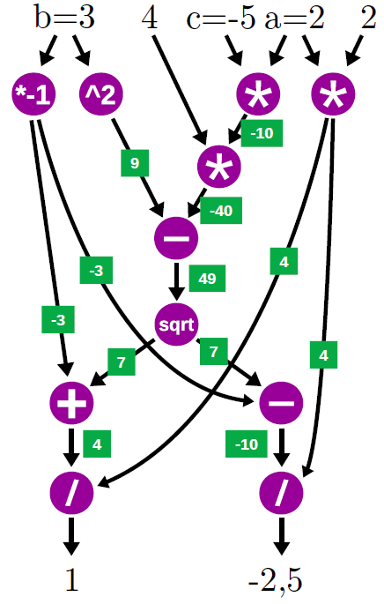
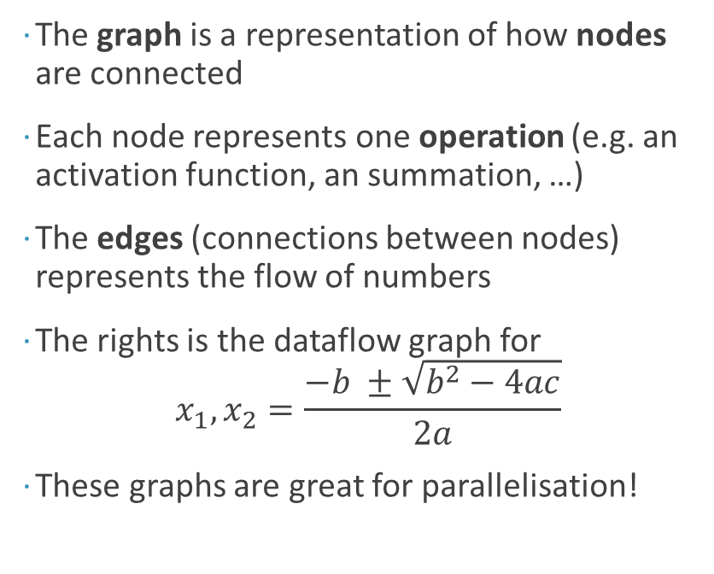
Data Flow Graph
The graph is a representation of how nodes are connected
Each node represents one operation (e.g. an activation function, an summation, …)
The edges (connections between nodes) represents the flow of numbers
The rights is the dataflow graph for $x_{1},x_{2}=\frac{−b ±\sqrt{b^{2}−4ac}}{2a}$
These graphs are great for parallelisation!
[5]

Slide 44
Homework

Slide 45
Floppy Ears, Fluffy Fur
This week is a repetition of sorts
You will need to implement a Tamagotchi-like program
The player takes care of a little bunny that can be fed, played with or ignored
If you play with it often, the bunny will grow to be a big happy bunny
Take care though if you don’t!

Slide 46
See you all next week!

Slide 47
References
[1] Introduction to Artificial Neural Networks with TensorFlow, Lukas Braun, 2017
[2] http://neuralnetworksanddeeplearning.com, Michael Nielsen, 2017
[3] https://colah.github.io/, Christopher Olah, 2018
[4] Machine Learning, Gunther Heidemann, 2018

